Slide 1
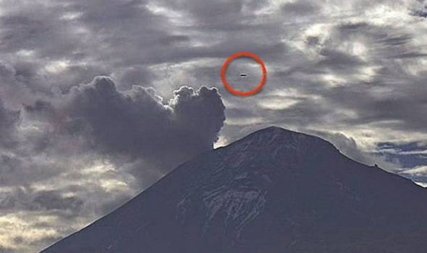
UFO Sightings & Natural Disasters: A Coincidence?
Nicholas Alonzo
Ethan Bell
Zora Wang
Madeline Ye
Notes:
http://cdn.images.express.co.uk/img/dynamic/80/590x/secondary/UFO-Volcano-297380.jpg

Slide 2
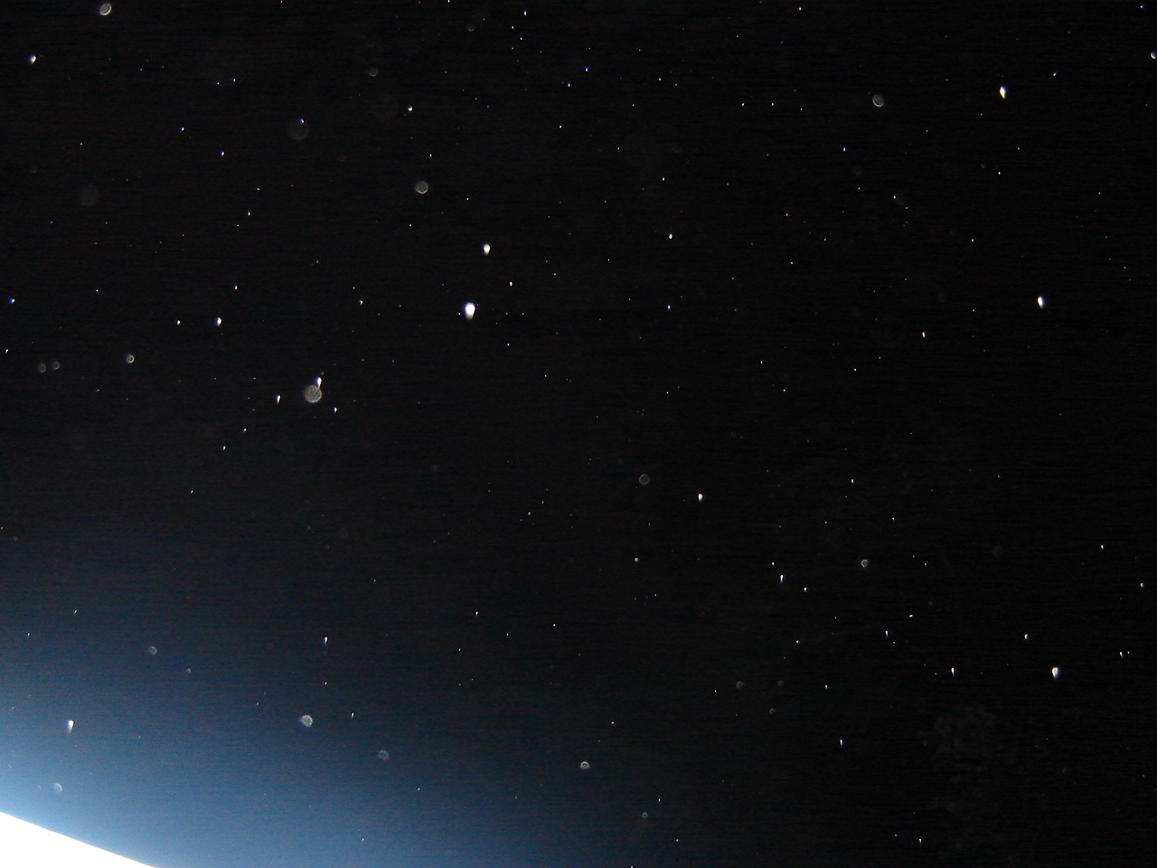
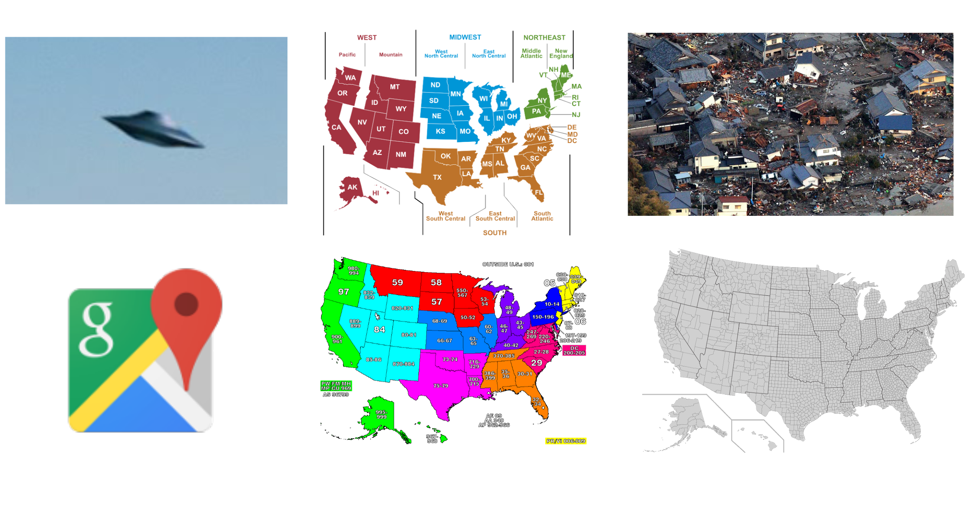
Data Pre-Processing
Notes:
Nick
https://commons.wikimedia.org/wiki/File:USA_Counties_with_FIPS_and_names.svg
https://4.bp.blogspot.com/-TUqfwRkTcNg/VTCuLvknErI/AAAAAAAAB5Q/eFsgT94l3uU/s1600/google-maps-logo.jpg
https://aipetcher.files.wordpress.com/2011/06/zip-codes-of-the-usa.jpg
https://pbs.twimg.com/profile_images/638753218613280768/zK11Va5r_400x400.png
https://upload.wikimedia.org/wikipedia/commons/6/6a/ZIP_code_zones.png
https://3.bp.blogspot.com/-UYGCAIF1k2g/Tx1WPe62tcI/AAAAAAAAC7c/Bb-LzpmuC78/s1600/UFO%252C+UFOs%252C+sighting%252C+sightings%252C+orb%252C+orbs%252C+area+51%252C+Cape+of+good+hope%252C+africa%252C+2011%252C+2012%252C+uredda%252C+alien%252C+aliens%252C+ET%252C+delete%252C+deleted%252C+google%252C+earth%252C+map%252C+conspiracy%252C+paranormal%252C+real2ca9adf9-af26-41b3-93a8-1c733c1dd02c180.jpg
http://assets.natgeotv.com/Shows/18515.jpg
https://routerabbit.com/wp-content/uploads/2014/09/Googlemaps-128.png
https://2.bp.blogspot.com/-b28yZl92jCg/UQH9xZ3QrQI/AAAAAAAAAE8/Nkq9q6a4B9c/s1600/badclouds.png

Slide 3
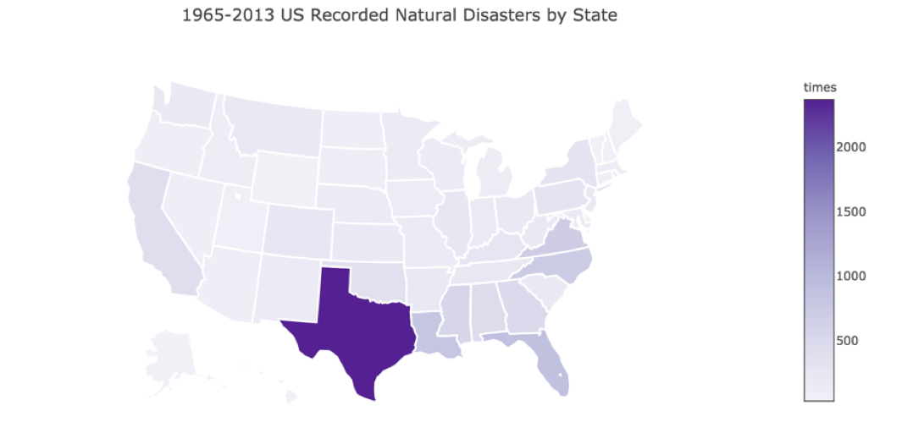
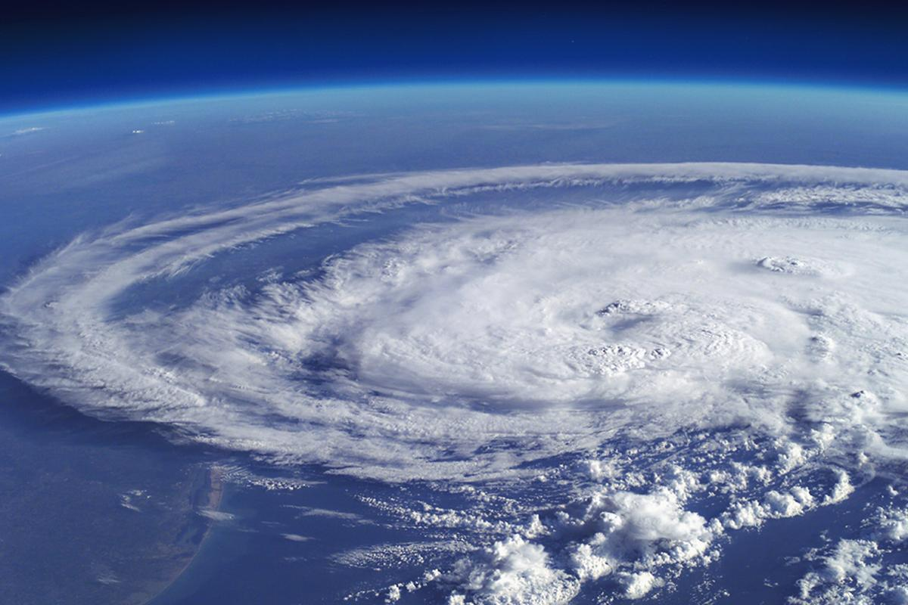
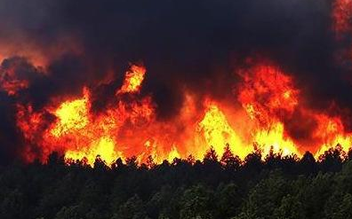
Top 3 States by Disaster
1. Texas | Hurricane (1,148), Fire (1115)
2. Florida | Hurricane (571), Fire (251)
3. Louisiana | Hurricane/Coastal Storm (772)
Notes:
Texas (2,353)
Florida (885)
Louisiana (805)

Slide 4
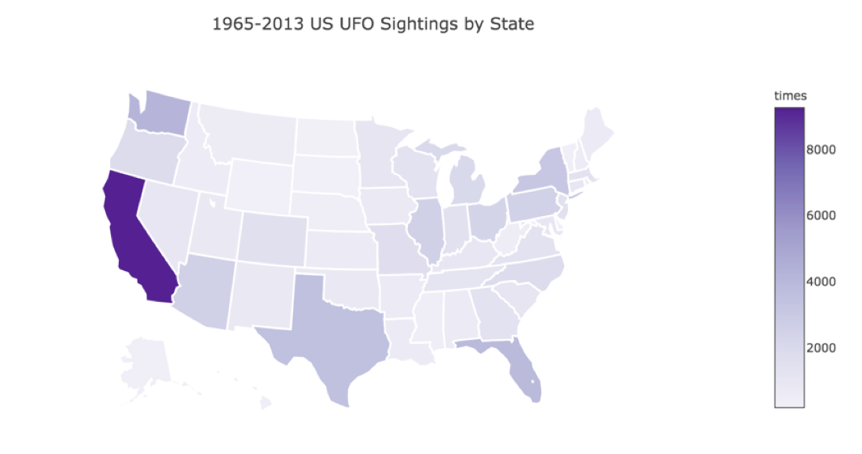
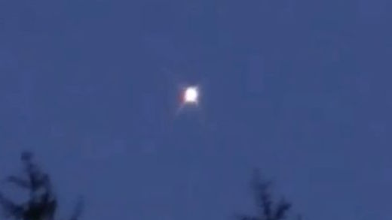
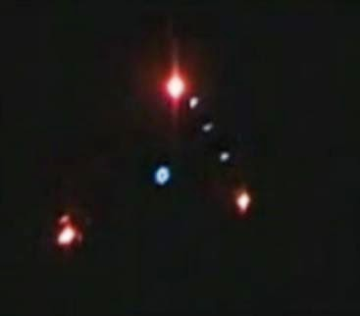
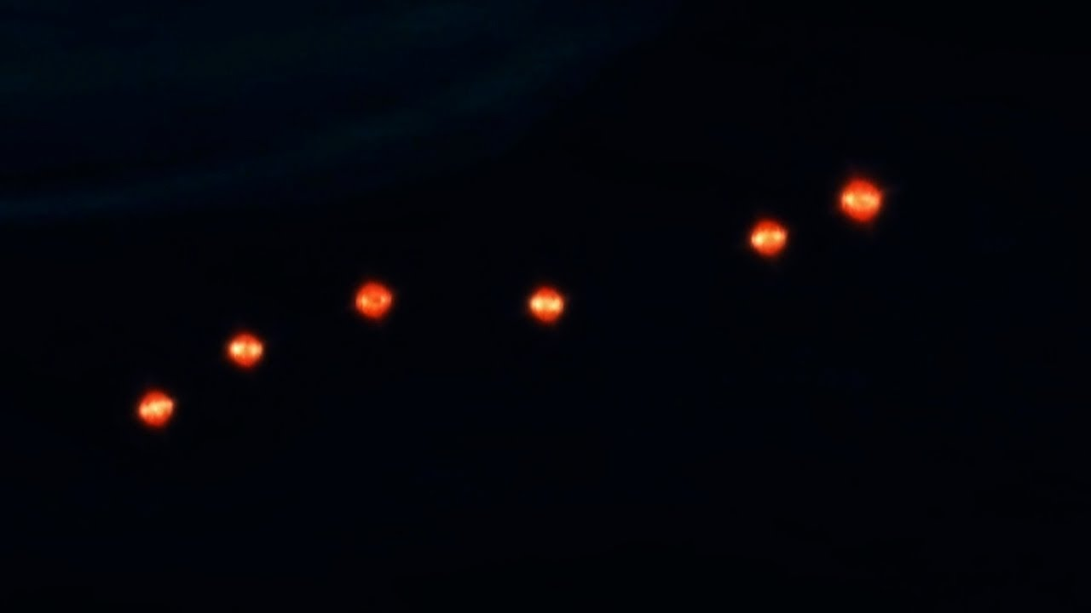
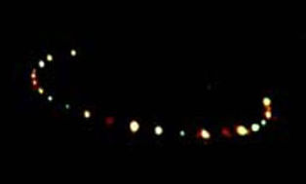
Light
Triangle
Fireball
Top 3 States by UFO Shape
1. California | Light (1953), Triangle (886), Circle (873)
2. Washington | Light (927), Fireball (376), Triangle (353)
3. Florida | Light (813), Fireball (446), Circle (386)
Circle

Slide 5
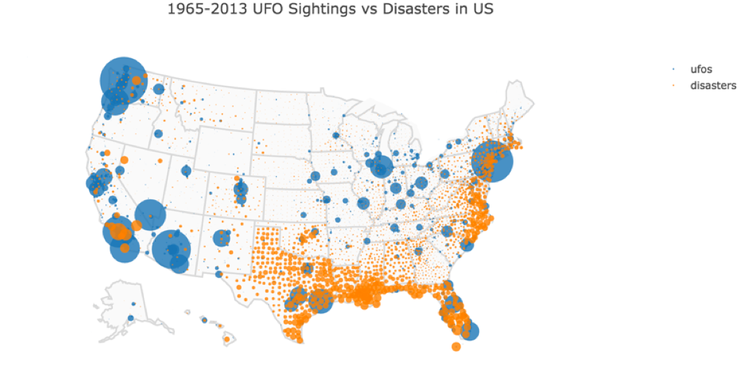
Notes:
Disasters top county: los angeles(40),
los angeles county：449, San Diego: 379，Sacramento: 219, San Jose: 195, San Francisco: 195
In California: Los Angeles, San Diego, Sacramento, San Jose, San Francisco

Slide 6
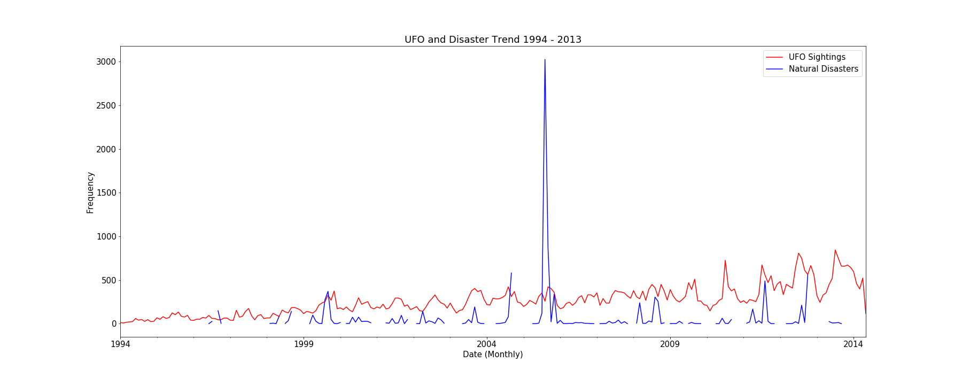
UFO & Natural Disasters by Month
Top months for UFO sightings: June – September
Top months for Natural Disasters: August – November
Notes:
There is some overlap with when natural disasters occur and when ufo sightings occur. We need to consider that most disasters only last about a day i.e. tornadoes

